Slide 1
Slides from the Text Book on Information Retrieval
Scoring, Term Weighting and the Vector Space Model

Slide 2
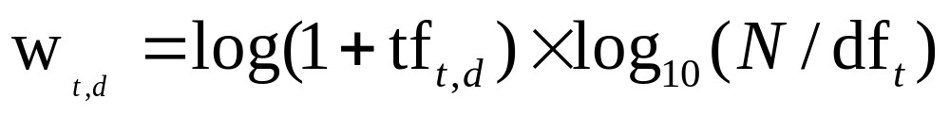
tf-idf weighting
Sec. 6.2.2
The tf-idf weight of a term is the product of its tf weight and its idf weight.
Best known weighting scheme in information retrieval
  Note: the “-” in tf-idf is a hyphen, not a minus sign!
  Alternative names: tf.idf, tf x idf
Increases with the number of occurrences within a document
Increases with the rarity of the term in the collection

Slide 3
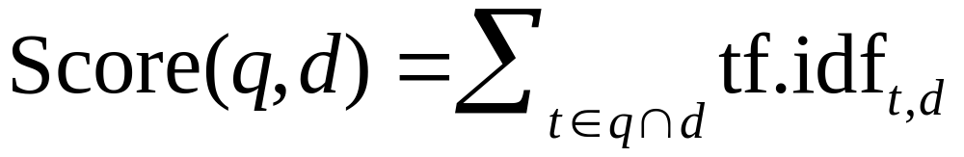
Score for a document given a query
Sec. 6.2.2
There are many variants
  How “tf” is computed (with/without logs)
  Whether the terms in the query are also weighted
  …

Slide 4

Binary → count → weight matrix
Sec. 6.3
Each document is now represented by a real-valued vector of tf-idf weights ∈ R^{|V|}

Slide 5
Documents as vectors
Sec. 6.3
So we have a |V|-dimensional vector space
Terms are axes of the space
Documents are points or vectors in this space
Very high-dimensional: tens of millions of dimensions when you apply this to a web search engine
These are very sparse vectors - most entries are zero.

Slide 6
Queries as vectors
Sec. 6.3
Key idea 1: Do the same for queries: represent them as vectors in the space
Key idea 2: Rank documents according to their proximity to the query in this space
proximity = similarity of vectors
proximity ≈ inverse of distance
Recall: We do this because we want to get away from the you’re-either-in-or-out Boolean model.
Instead: rank more relevant documents higher than less relevant documents

Slide 7
Formalizing vector space proximity
Sec. 6.3
First cut: distance between two points
  ( = distance between the end points of the two vectors)
Euclidean distance?
Euclidean distance is a bad idea . . .Why?
. . . because Euclidean distance is large for vectors of different lengths.

Slide 8

Why distance is a bad idea
Sec. 6.3
The Euclidean distance between q
and d₂ is large even though the
distribution of terms in the query q and the distribution of
terms in the document d₂ are
very similar.

Slide 9
Use angle instead of distance
Sec. 6.3
Thought experiment: take a document d and append it to itself. Call this document d′.
“Semantically” d and d′ have the same content
The Euclidean distance between the two documents can be quite large
The angle between the two documents is 0, corresponding to maximal similarity.
Key idea: Rank documents according to angle with query.

Slide 10
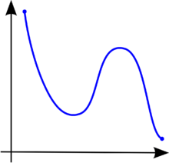
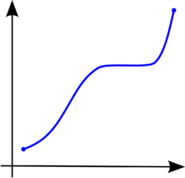
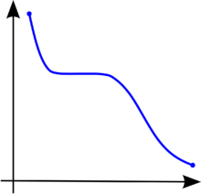
From angles to cosines
Sec. 6.3
.
  Rank documents in decreasing order of the angle between query and document – A minor issue?
  Rank documents in increasing order of cosine(query,document) – Why Cosine?
Cosine is a monotonically decreasing function for the interval [0º, 180º]

Slide 11
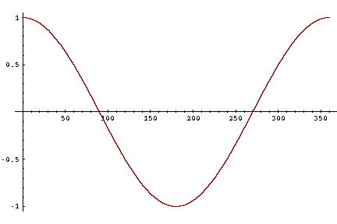
From angles to cosines
Sec. 6.3
But how – and why – should we be computing cosines?

Slide 12
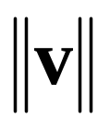
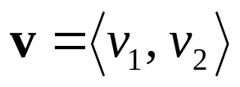
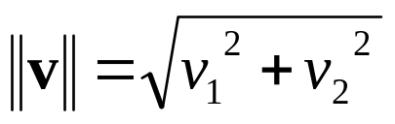
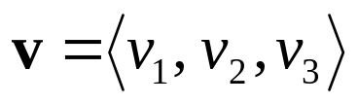
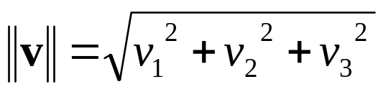
The length of a vector
The length of a vector is the distance between its initial point and its terminal point. The length is also called the magnitude and the norm of the vector, and has notation .
If is a vector in R², its norm is
If is a vector in R³ , its norm is

Slide 13
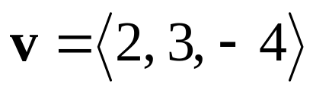
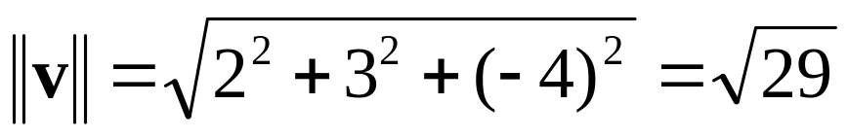
The length of a vector
Ex. Find the norm of the vector
Unit Vectors
A unit vector is any vector of length 1

Slide 14
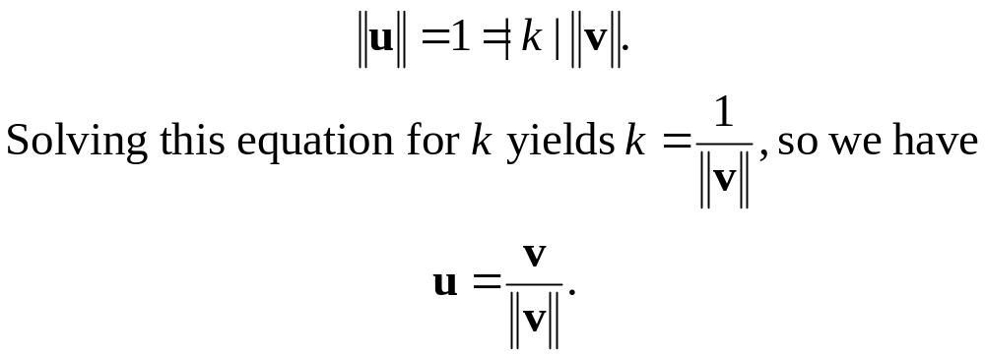
Normalizing a Vector
Given a vector v, it is a common problem to find a unit vector u that is parallel to v. This is called normalizing v.
Since u is parallel to v, there exists a scalar k such that u = kv. Since u is a unit vector,

Slide 15
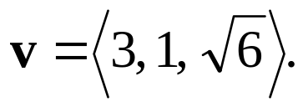
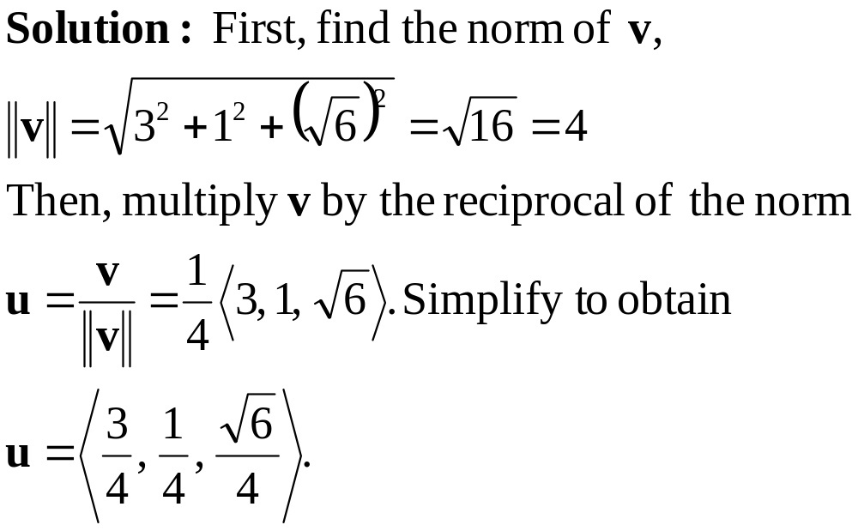
Normalizing a Vector
Find the unit vector u that has the same direction as

Slide 16
Why Unit Vectors?
The idea of a unit vector is to specify a direction only.
Since a unit vector u has ||u|| = 1, we can form a vector v of length k in the direction of u that by v = ku.
Proof: ||v|| = |k| ||u||= |k| (1) = k.

Slide 17
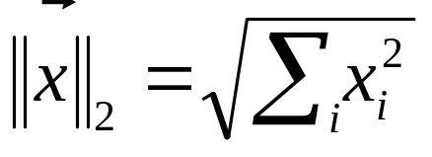
Length normalization
Sec. 6.3
A vector can be (length-) normalized by dividing each of its components by its length – for this we use the L₂ norm:
Dividing a vector by its L₂ norm makes it a unit (length) vector (on surface of unit hypersphere)
Effect on the two documents d and d′ (d appended to itself) from earlier slide: they have identical vectors after length-normalization.
  Long and short documents now have comparable weights

Slide 18

cosine(query,document)
Sec. 6.3
Dot product
Unit vectors
q_{i} is the tf-idf weight of term i in the query
d_{i} is the tf-idf weight of term i in the document
cos(q,d) is the cosine similarity of q and d … or,
equivalently, the cosine of the angle between q and d.
Notes:
See Law of Cosines (Cosine Rule) wikipedia page

Slide 19


Cosine similarity illustrated

Slide 20
Cosine similarity exercises
Exercise: Rank the following by decreasing cosine similarity:
  Two docs that have only frequent words (the, a, an, of) in common.
  Two docs that have no words in common.
  Two docs that have many rare words in common (wingspan, tailfin).

Slide 21
Which documents are similar according to VSM
auto
engine
bonnet
tyres
lorry
boot
car
emissions
hood
make
model
trunk
make
hidden
Markov
model
emissions
normalize
Which documents are semantically similar
D1 D2 D3

Slide 22
Synonymy and Polysemy
auto
engine
bonnet
tyres
lorry
boot
car
emissions
hood
make
model
trunk
make
hidden
Markov
model
emissions
normalize
Synonymy
Will have small cosine
but are related
Polysemy
Will have large cosine
but not truly related

Slide 23
Cosine similarity amongst 3 documents
Sec. 6.3
How similar are
the novels
SaS: Sense and
Sensibility
PaP: Pride and
Prejudice, and
WH: Wuthering
Heights?
term | SaS | PaP | WH
affection | 115 | 58 | 20
jealous | 10 | 7 | 11
gossip | 2 | 0 | 6
wuthering | 0 | 0 | 38
Term frequencies (counts)
Note: To simplify this example, we don’t do idf weighting.

Slide 24
3 documents example contd.
Sec. 6.3
Log frequency weighting
After length normalization
term | SaS | PaP | WH
affection | 3.06 | 2.76 | 2.30
jealous | 2.00 | 1.85 | 2.04
gossip | 1.30 | 0 | 1.78
wuthering | 0 | 0 | 2.58
term | SaS | PaP | WH
affection | 0.789 | 0.832 | 0.524
jealous | 0.515 | 0.555 | 0.465
gossip | 0.335 | 0 | 0.405
wuthering | 0 | 0 | 0.588
cos(SaS,PaP) ≈
0.789 × 0.832 + 0.515 × 0.555 + 0.335 × 0.0 + 0.0 × 0.0
≈ 0.94
cos(SaS,WH) ≈ 0.79
cos(PaP,WH) ≈ 0.69
Why do we have cos(SaS,PaP) > cos(SaS,WH)?

Slide 25

tf-idf weighting has many variants
Sec. 6.4
Columns headed ‘n’ are acronyms for weight schemes.
Notes:
n default is just term frequency
ltc is best known form of weighting

Slide 26
Class Exercise
Doc 1: interest in real estate speculation
Doc 2: interest rates and rising home costs
Doc 3: kids do not have an interest in banking
Doc 4: lower interest rates, hotter real estate market
Doc 5: feds interest in raising interest rates rising
stopwords: an, and, do, in, not
Indicate the order in which documents will be retrieved
by calculating the similarity score between
the query and each document.
Query 1: interest rising
Query 2: real estate interest

Slide 27
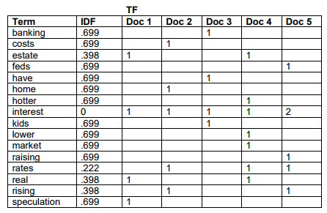
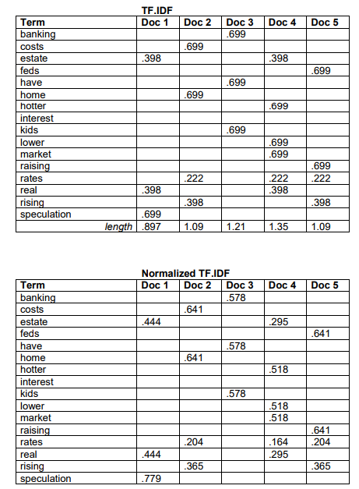

Slide 28
interest rising
Doc 2: .365
Doc 5: .365
Doc 1: 0
Doc 3: 0
Doc 4: 0
real estate interest
Doc 1: .888
Doc 4: .59
Doc 2: 0
Doc 3: 0
Doc 5: 0

